Slide 1
Agricultural Revocation - How to install new devices
June 1, 2021

Slide 2
Summary
Below is a list of items that would be covered in this presentation:
  List various applicable codes that apply to different devices
  Rules and information about Canadian Registration Numbers (CRNs)
  What is a Data Report and why are they important
  Information about Certificate of Authorization holders
  What are the requirements for installing rental equipment

Slide 3
GENERAL INFORMATION: DISCLAIMER
This presentation is intended to provide guidance to individuals in the Agricultural industry that own/operate Boilers, Pressure Vessels and Pressure Piping. While efforts have been made to present current, accurate and pertinent information, this presentation is not intended to be a complete reference manual for guiding the actions of individuals working on issues relating to Boiler, Pressure Vessel and Pressure Piping Code compliance. Before applying the information in this presentation, users must weigh its applicability against the particular and unique circumstances of each situation, as well as any other relevant policies or guidelines including the CSA B51 Boiler, Pressure Vessel and Pressure Piping Code and its referenced Codes and Standards, including NBIC. TSSA is not responsible for any actions or omissions by users of this manual, or for the use of or reliance on the information contained in this presentation, or for errors or omissions relating to the contents of this presentation.

Slide 4
GENERAL INFORMATION: DISCLAIMER
Copyright Statement
© Technical Standards and Safety Authority – TSSA (2003). All right reserved. No part of this publication may be reproduced, stored in a retrieval system, or transmitted or published in any form or by any means without the prior written permission of the Technical Standards and Safety Authority.

Slide 5
OUTLINE
1. CSA B51 Boiler, Pressure Vessel & Pressure Piping Code
2. What are Canadian Registration Numbers (CRN)
Data Reports
Certificate of Authorization holder requirements
Rental and Temporary Equipment Installations

Slide 6
SECTION 1
CSA B51
Boiler, Pressure Vessel & Pressure Piping Code

Slide 7
CSA B51
CSA B51 the Boilers, Pressure Vessel and Pressure Piping Code is adopted in the Province of Ontario with exceptions
CSA B51 is a Code that references all construction codes to be used for pressure equipment in Canada

Slide 8

CSA B51
CSA B51 Boilers, Pressure Vessel and Pressure Piping Code is more of an administrative Code utilized by the provinces. However, it does have some specific requirement with regards to Boilers, Pressure Vessels,
Piping & Fittings
It is important to note that Ontario takes exception to some of the requirements in B51 (Refer to the TSSA Code Adoption Document)

Slide 9
APPLICABLE CODES
The Applicable Codes for the manufacture, installation and repairs to pressure equipment are referenced in CSA B51 and/or Code Adoption Document
Examples include :
ASME B31.1 Power Piping
ASME B31.3 Process Piping
CSA B31.5 Refrigeration Piping and Heat Transfer Components
ASME Section I Rules for Construction of Power Boilers
ASME Section IV Rules for the Construction of Heating Boilers
ASME Section VIII Rules for Construction of Pressure Vessels Division 1
NBIC (National Board Inspection Code)

Slide 10

SECTION 2
Canadian Registration Numbers (CRNs)
Boilers, Pressure Vessels, Piping & Fittings

Slide 11
CRNs: GENERAL REQUIREMENTS
TSSA issues CRN numbers for Boilers, Pressure Vessels and piping that are suitable for use in the province of Ontario.
TSSA performs an independent review of the designs to ensure safety and code compliance.

Slide 12
CRNs: PIPING SYSTEMS
Examples:
Another form of CRN is a Piping registration Number
(Referred to as a P#)
A number given to piping system designs by the TSSA for the Registration of piping systems
Example of a P#, P12345
  Note: Design registration is required in Ontario for piping systems. Owners are responsible to have piping systems registered.

Slide 13
CRNs: PIPING
Installing New Piping
Design Registration with TSSA is required
The link below will provide a guideline for registering a piping design, along with the application: Register a Design – TSSA
Please ensure that the piping will be fabricated by a company holding a valid COA for piping. Below is a link that can be used to find a local COA holder: TSSA - Certificate Business Directory
Contact your local Inspector prior to starting the fabrication. Below is a link to the directory of Inspectors as well as information on how to book the inspection: Inspections - TSSA

Slide 14
REGISTRATION OF FITTINGS
Definition of a Fitting?
  An appurtenance that is attached to or used in connection with a boiler, a pressure vessel or piping and includes such things as valves, gauges and controlling devices and other pressure-retaining components; (“accessory”)
Any fitting attached to a Boiler, Pressure vessel or Piping System requires registration in the province of Ontario.
Registration of Fittings are done by the Fitting Manufacturer.
    Note: Fittings can be registered as part of the piping design.

Slide 15
REGISTRATION OF FITTINGS
Registration of fittings:
The number allotted to a registered design of any fitting shall be a number preceded by zero and category letter followed by a decimal point, to the right of which shall be added the digit or letter indicating the first province of registration.
e.g., A flange design registered in Manitoba will be allotted a number such as 0B675.4
There are other registration numbers that would be used for Fittings. These CRNs would end with a .FITG

Slide 16
REGISTRATION OF WELDING & BRAZING PROCEDURES
Welding and Brazing Procedures are registered by the Certificate Holder (Contractor) for their welding/brazing procedures utilized.
Welding and Brazing Procedures shall be registered with the regulatory authority of the province, where the welding or brazing is to be performed.
NOTE: Review the Boilers and Pressure Vessel Regulations for Ontario requirements.
Owners are not allowed to perform weld repairs unless they hold a COA from TSSA or a Repair Certificate form National Board.

Slide 17
CERTIFICATION OF WELDERS & BRAZERS
Any Welder, Brazer or Welding/Brazing Operator shall be certified by TSSA if welding/brazing is carried out in Ontario.
Each Welder/Brazer is given a Certification from the TSSA.
Certifications are valid for 1 year unless otherwise indicated on the Certification.

Slide 18
SAFETY BULLETINS
Examples:
  Reference TSSA Safety Bulletin SB00-7 Rev 4 (Guide for Registration of piping systems in Ontario Flow Chart)
  SB00-2 Rev. 1(Modifications/Alterations to Registered Conventional Piping Systems)

Slide 19
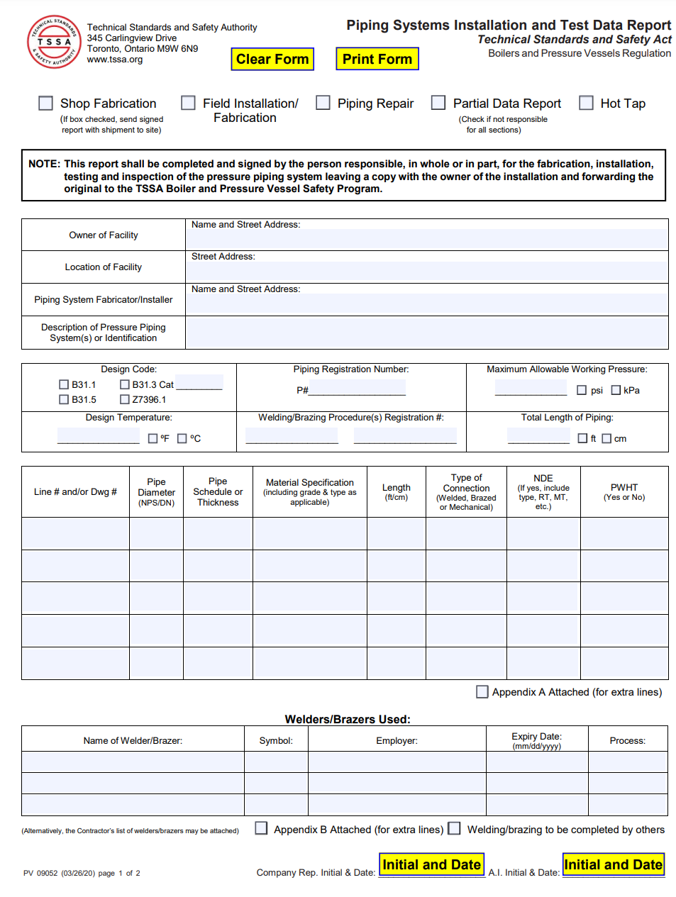
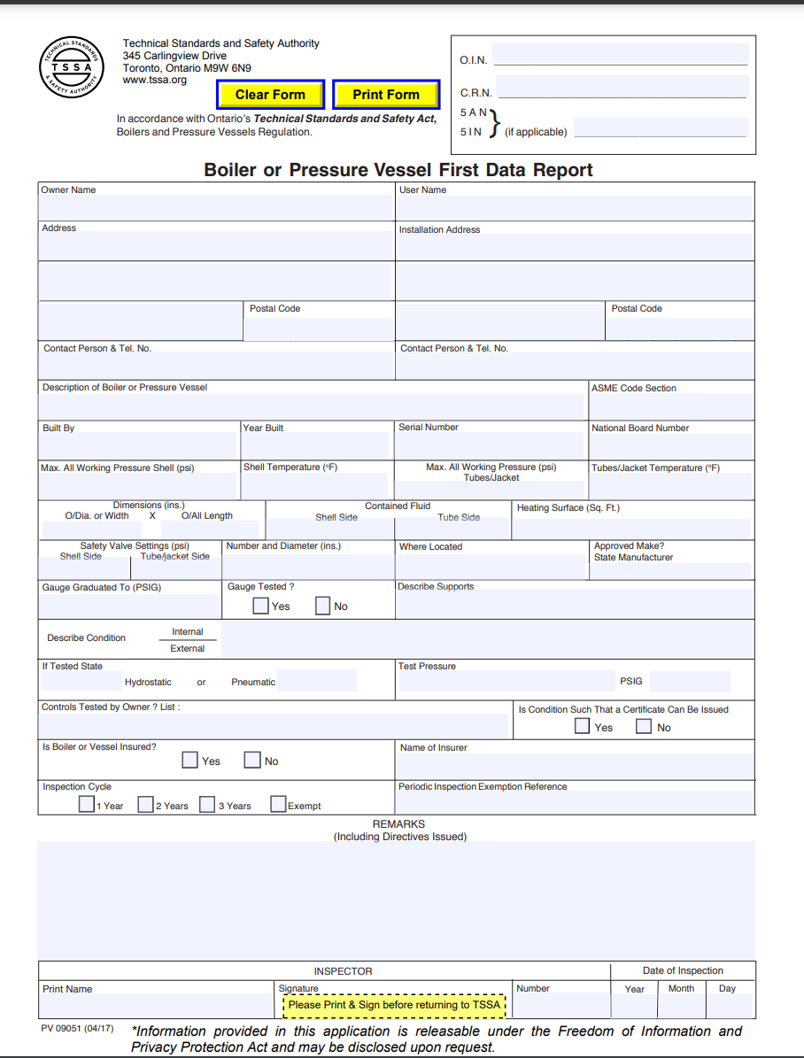
SECTION 3
Data Reports

Slide 20
DATA REPORTS: BOILERS & PRESSURE VESSELS
Boilers and Pressure Vessels will be supplied with the Data Report from the Manufacturer when purchased new.
If buying a used Boiler or Pressure Vessel, the Data Report should still be supplied when available. If not available, it may be obtained through the TSSA, the National Board or from original manufacturer if still in business.
If a Data Report can not be obtained, the TSSA shall be contacted.

Slide 21
DATA REPORTS: BOILERS & PRESSURE VESSELS
Data reports serve as a record of the work that was performed, who performed the work and who approved it. These should be kept as permanent records.
The Data Report is used by Owners & Inspectors when installing the Boiler or Pressure Vessel, repairing, altering and maintaining.
The Data Report should be kept in a location by the Owner where it can be easily retrieved when required.
The TSSA Inspector will create a TSSA First Inspection Data Report when the Boiler or Pressure Vessel is first installed. This is a unique Data Report to the TSSA.

Slide 22
DATA REPORTS: PIPING INSTALLATIONS
A TSSA Piping System Installation and Test Data Report is created by the Certificate of Authorization Holder (Contractor)
The Data Report is signed by the Certificate of Authorization Holder and the TSSA Inspector upon an acceptable installation.
The Piping Data Report details the registration number(P#), pressures, temperatures, materials, pipe sizes, thicknesses an amount of piping installed etc.

Slide 23
DATA REPORTS: PIPING INSTALLATIONS
The Owner should keep this Data Report in a safe location where it can be readily accessed when required.
The Data report is a very helpful document when repairs or new additions are to be completed on the Piping System.
Owners are required to demonstrate compliance.

Slide 24
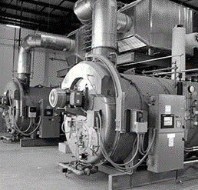
SECTION 4
Certificate of Authorization (COA) holder requirements

Slide 25
COA Holder requirements
Every COA holder has:
  A defined scope that allows the company to perform a specific type of work.
  A Quality Manual that describes the rules and controls for the work specified on the COA scope.
  Trained and qualified individuals for various tasks such as Welding and Brazing.
  COA holders are Audited by TSSA every 3 years.

Slide 26
SECTION 5
Rental & Temporary Equipment Installations

Slide 27
Requirements for Rental and Temporary devices
When renting Boilers or Pressure Vessels that would be covered under the Regulation. All rules regarding new equipment should be followed.
A First inspection would be required.
Any piping work to connect to the existing system would need to be registered.
The piping work would need to be fabricated by a company holding a valid COA from TSSA.

Slide 28
Rental & Temporary Equipment
When Boilers and Pressure Vessels are rented, they are required to follow the process for newly installed equipment.
A First Inspection will be performed, and a COI will be issued.
If any additional piping is required to connect the equipment:
  Piping registration would be required.
  The company performing the work will require a COA.
  TSSA will perform a piping inspection.

Slide 29
Thank You
for Attending TSSA’s Ontario Regulations Overview Seminar

